Slide 1


To
Girls
Everywhere
Francisca Giaverini
Talya Erblich
Daniela Gomez

Slide 2

Problem:
62 Million Girls do not have access to education
People need to do a lot of research to educate themselves properly about the girls education systems in developing countries.
We put all the research in one place.

Slide 3
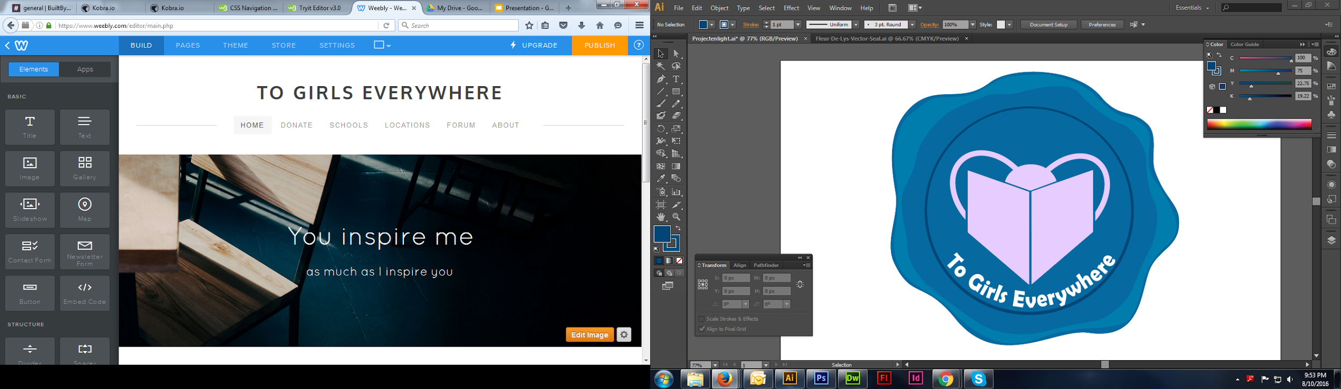
Solution:
Bridge between users and sponsor organizations promoting girl’s education
Provide a list of countries in need and corresponding organizations for each one
Educate users about the condition of girls’ education in third world countries
A Forum encourages people to get involved and fundraise money

Slide 4

Target:
All Americans, including children and teenagers
Stretch goal: Expand the target audience to outside the United States
Notes:
Might take off

Slide 5
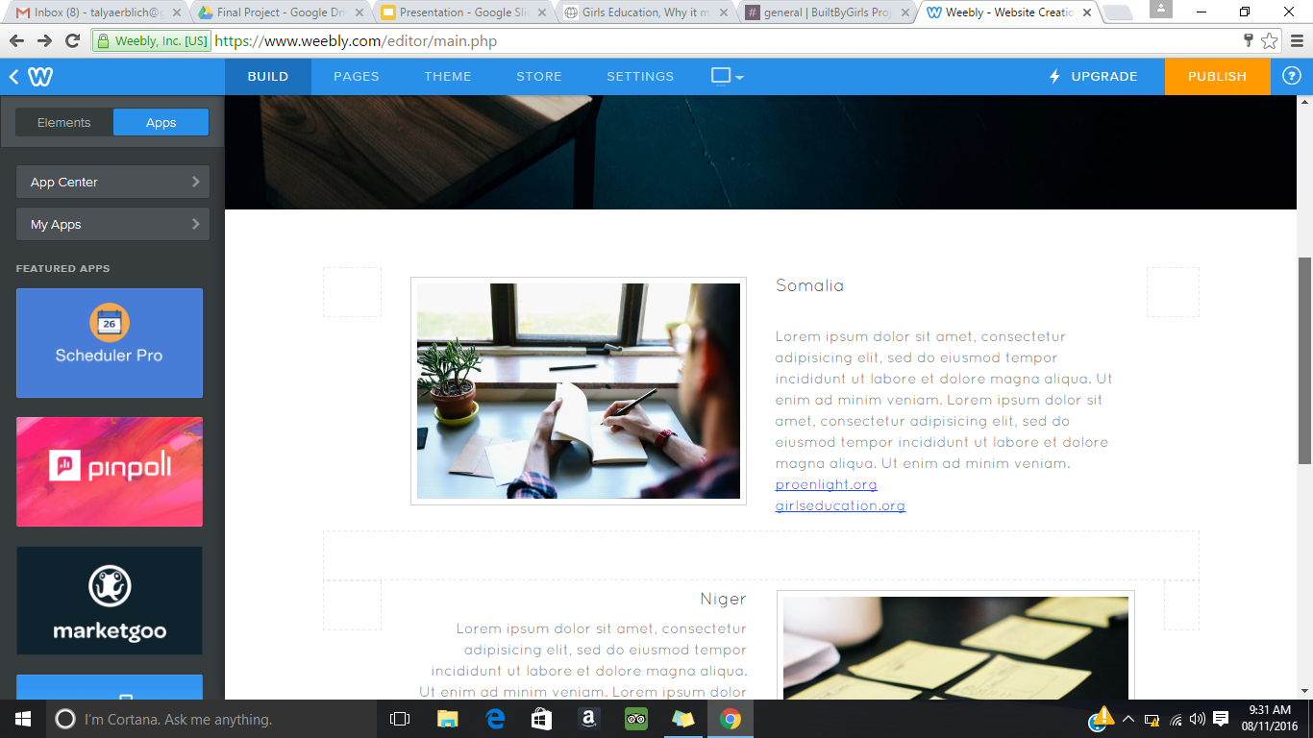
Opportunity:
There are many organizations working to aid developing countries, but To Girls Everywhere puts them all in one place.
To Girls Everywhere provides users with links
The user has the freedom to choose which organization he/she wants to support.

Slide 6
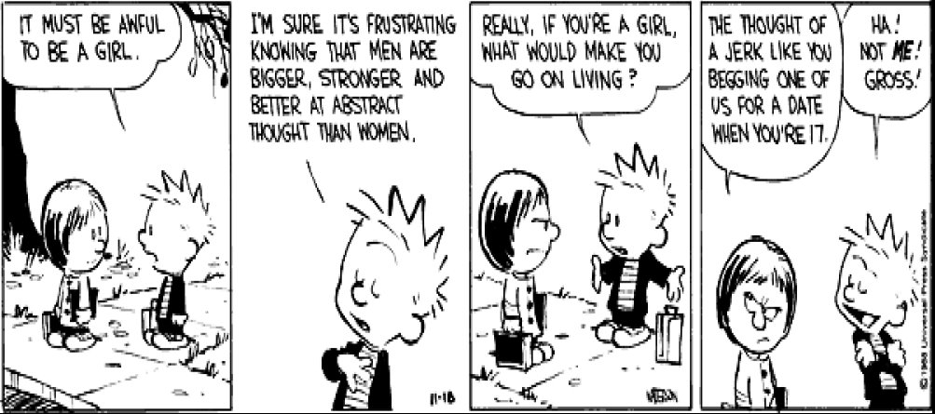
Why We Do This:
We believe that girls have the right to an education just as much as men
Girls should not feel weak and alone
All girls should have the same opportunities

Slide 7

What Is Next:
Expand our target audience to other countries
Create a page that sells merchandise promoting girls’ education
Plan volunteer trips to developing countries
Monitor the forum to keep all posts relevant.
Create a pen pal system
Partner with sponsor organizations so that users don’t need to visit their pages to donate

Slide 8
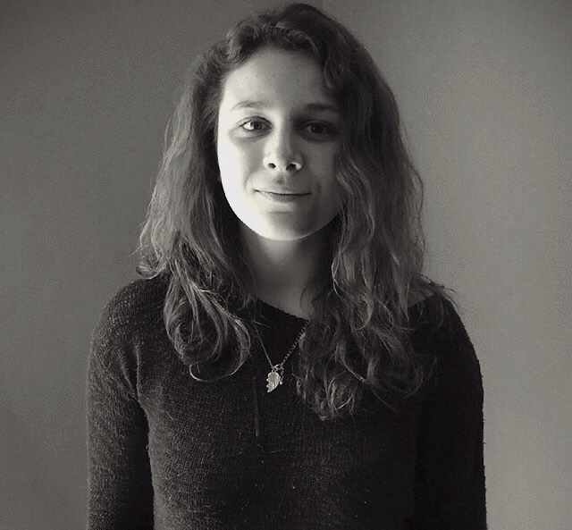
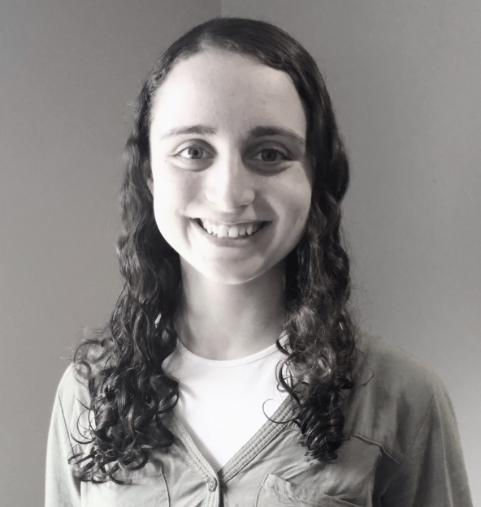
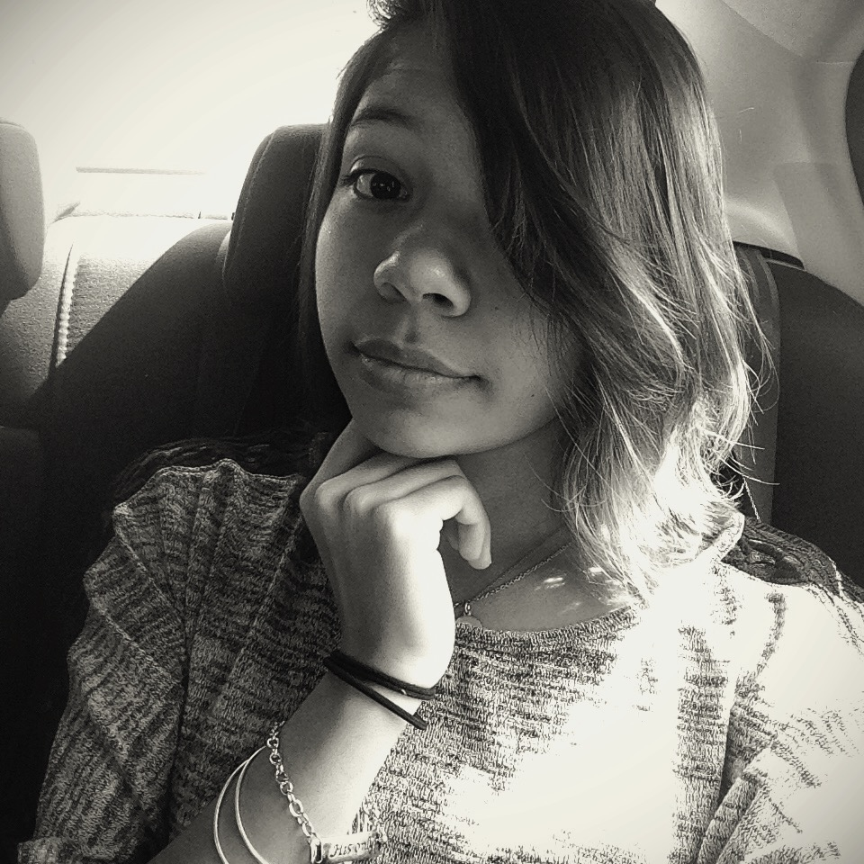
About Us:
Francisca
Talya
Daniela
Genius.
Friendly.
Compassionate.
Writer.
Creative.
Determined.
Coder.
Artistic. Detail Oriented.

Slide 9
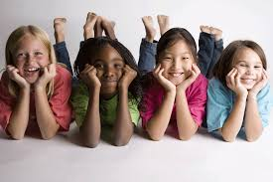
The End

Slide 10

Maps
our office

Slide 11
SlidesCarnival icons are editable shapes.
This means that you can:
Resize them without losing quality.
Change line color, width and style.
Isn’t that nice? :)
Examples:

